Slide 1
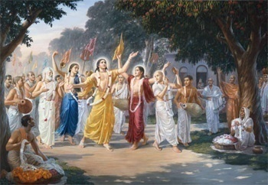
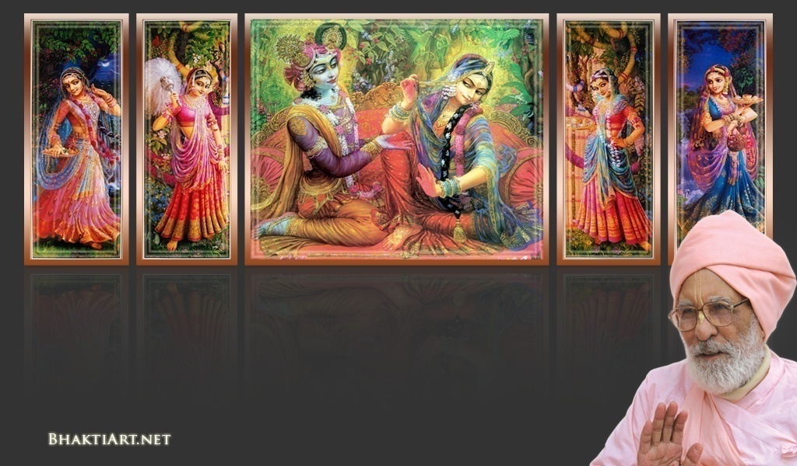
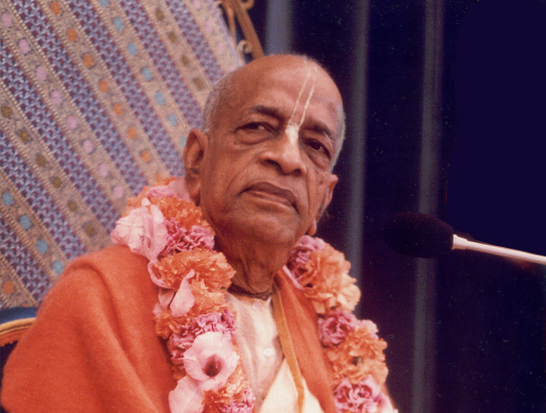
Sri Krsna Caitanya Prabhu Nityananda
Sri Advaita Gadadara Srivasadi
Gaura Bhakta Vrinda
Week 352
Aug 07
2015
Hare Krsna Hare Krsna
Krsna Krsna Hare Hare
Hare Rama Hare Rama
Rama Rama Hare Hare
Gokul Bhajan & Vedic Studies
North Carolina, USA
Notes:
Om Ajnana timirandhasya, jnananjana salakaya
Caksur unmimiltam yena, tasmai sri gurave namah
Namah om vishnu padaya, radhikayah priyatmane
Sri-srimad bhaktivedanta, narayana iti namine
Narayanam gurum vande, Saranam bhakta bāndhavam
Gaura manobhishtam poornam, Radha dāsyam pradāyakam
Rupānugācarya varyam, Rupa manjari preshtakam
Patita pāvana bāndhava, Yugācarya nārāyanam
Sri krishna lila kathane sudaksham, Audarya-madhurya gunais ca yuktam
Varam varenyam purusham mahantam, Narayanam tvam sirasa namami
He krishna karuna sindho, dina bandho jagat pate
Gopesha gopika kanta, radha kanta namo ‘stu te
Tapta kancana gaurangi, radhe vrindavaneshvari
vrsabhanu sute devi, pranamami hari priye
bhajami radham aravinda netram, smarami radham madhurasmi-tasyam
vadami radham karuna bharardram, tato mam anyasti gatir na kapi
bhaktya vihina aparadha-laksaih, ksiptas ca kamadi-taranga-madhye krpamayi tvam saranam prapanna, vrnde namas te caranaravindam
--------------------------
First of all, I pay my koti dandavat pranams to my diksha guru Om vishnupada rupanuga acharya Sri Sri Bhakti Vedanta Narayana Goswami maharaja. My koti dandavat pranams to Sri Sri Bhakti Vedanta Swami Prabhupada, and guru varga.
My humble pranams at the lotus feet of all assembled devotees, vaishnavas and vaishnavis..

Slide 2
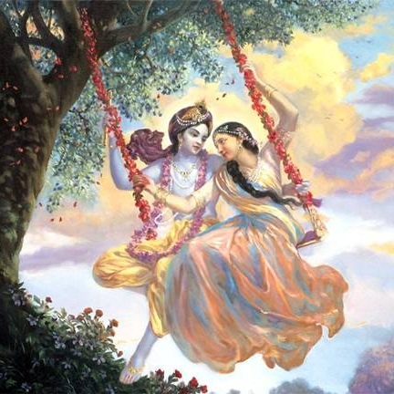
Jaya Rādha Mādhava
Jaya Kunja Vihārī
Jaya Gopī Jana Vallabha
Jaya Giri Vara Dhārī ... (Jaya)
Yaśodā Nandana Vraja Jana Ranjana
Yamunā tīra Vana Cāri ... (Jaya)
[ Hare Krishna Hare Krishna
Krishna Krishna Hare Hare
Hare Rāma Hare Rāma
Rāma Rāma Hare Hare ]

Slide 3
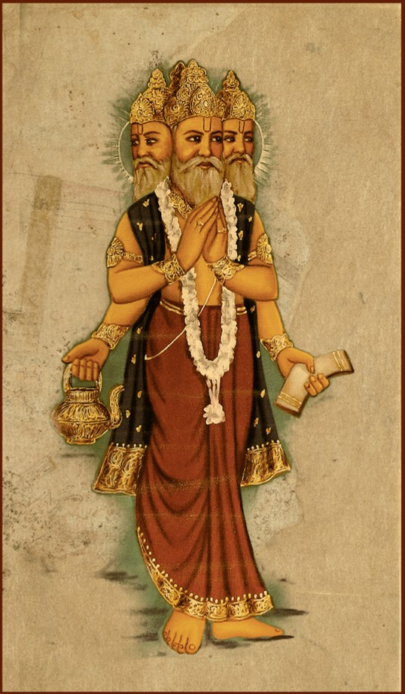
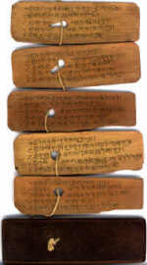
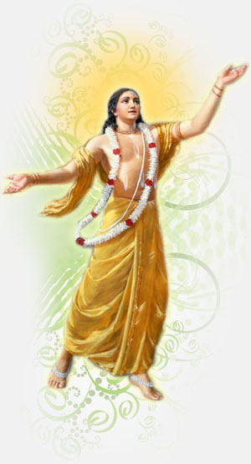
Slides Video
Brahma Samhita

Slide 4
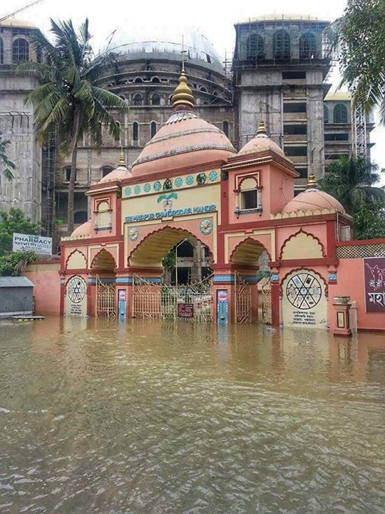
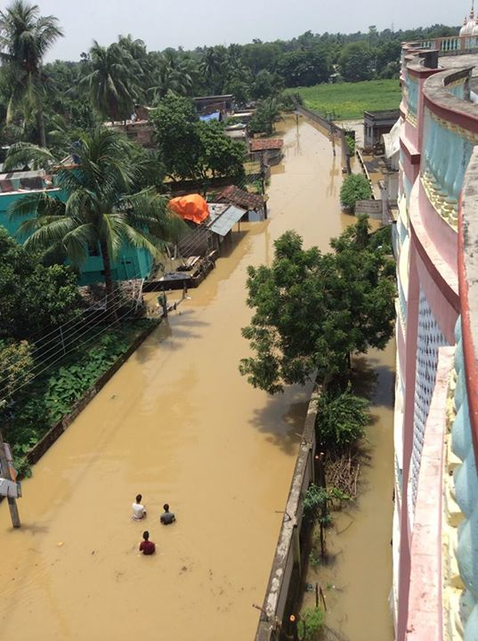
Ganga has Flooded in Nawadwip

Slide 5
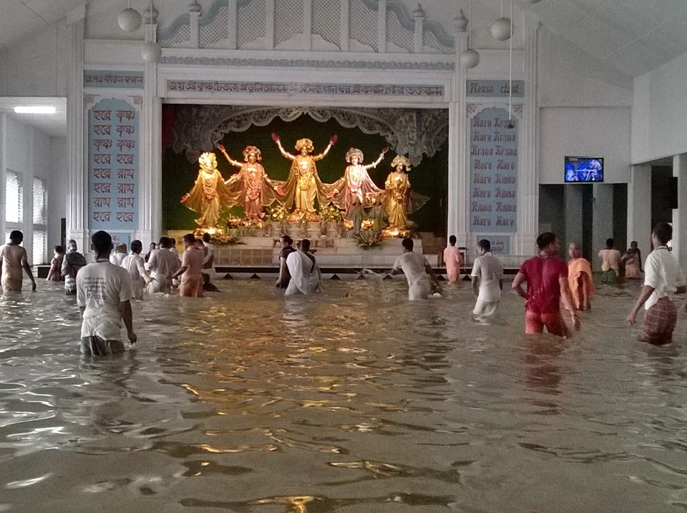

Slide 6
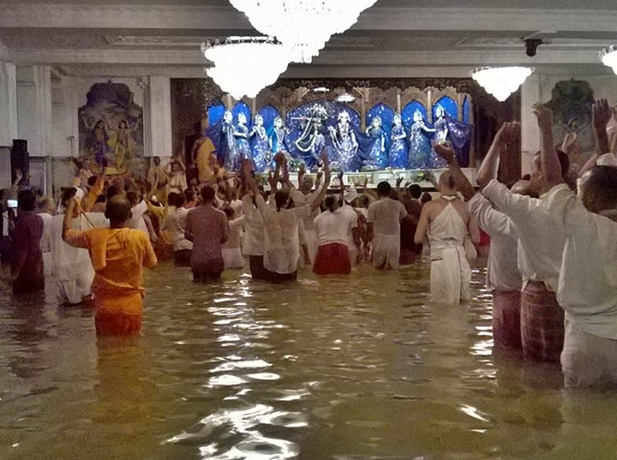

Slide 7
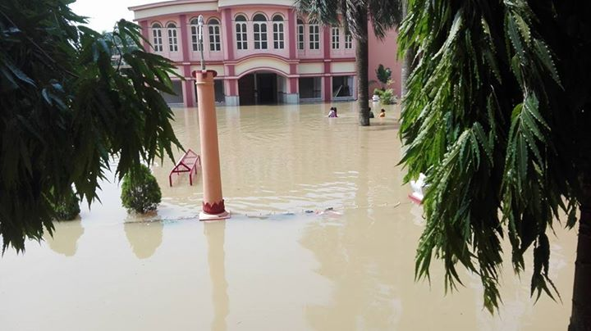

Slide 8
Guru Poornima
(July 31, 2015)

Slide 9
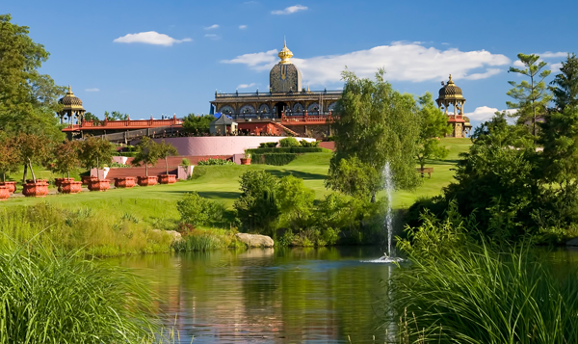

Slide 10
Bonafide Guru is extremely difficult to find....
Notes:
KANAKā
KāMINI
PRATHISHTā
BāGINI

Slide 11
ON THE FLY SLOKA!
Only a fortunate soul gets a Bonafide Guru
CC-33
krsna yadi krpā kare kona bhāgyavāne
guru-antaryāmi-rūpe, śikhāya āpane
... CC Madha 22.47
[ By the mercy of Krishna, a fortunate soul is guided by the Supersoul from within, and by the Guru from with-out]
Notes:
kṛṣṇa — Lord Kṛṣṇa;
Yadi — if;
kṛpā kare — shows His mercy;
kona - some
bhāgyavāne — to fortunate person;
guru — of the spiritual master;
antaryāmi — of the Supersoul;
rūpe — in the form;
śikhāya — teaches;
āpane — personally.

Slide 12
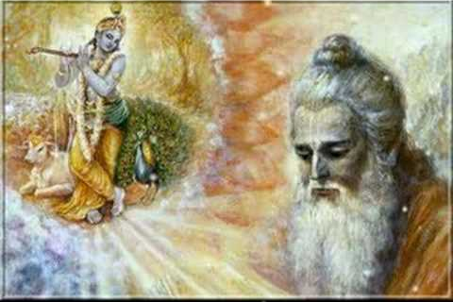
Notes:
To whom does Krishna show real mercy?
Selfish versus Selfless
Padmavati got darshan instead of Jayadeva Goswami

Slide 13
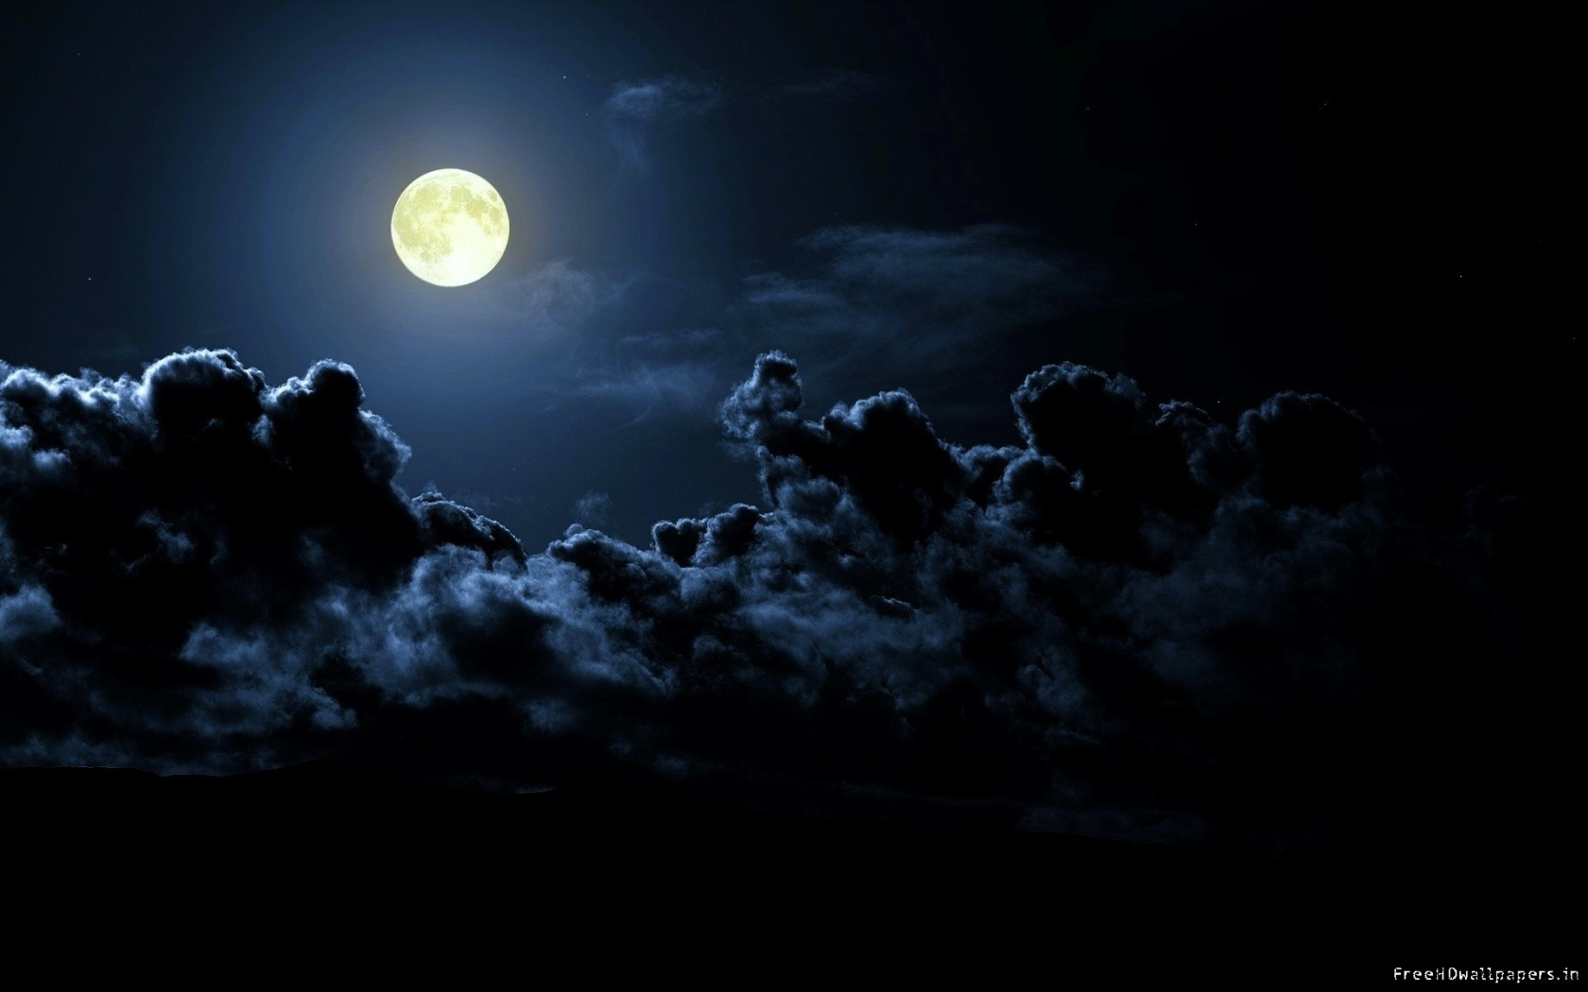
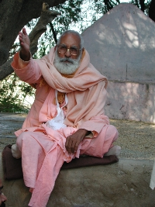
E-93
Yellām Gurudev, Yenakkellām Gurudev
Yellaiyillā Jagat Gurudev ... (Yellām)
Kālaiyilum Mālaiyilum
Karuththāi Entha Velaiyilum
Karunaiyulla Gurudevai
Chiram Thāzhthi Pāduvom ... (Yellām)
Rādhai-in Preeyamām
Ramana Manjari Perumām
Yirakkamulla Devanām
Enthan Sontha Moolamām ... (Yellām)
Gaura Deva Sevane
Kānjana Devi Nesame
Koti Koti Janmamum
Kidaikkumo Nam Gurudev ... (Yellām)
Rāja Rāja Ranjini
Ramana Devi Sundari
Rādhā Krishna Sevaiyai
Nalgum Deva Manjari ... (Yellām)
(Guru Poornima - July 31, 2015)
Notes:
EXPLAIN THE MEANING.....

Slide 14
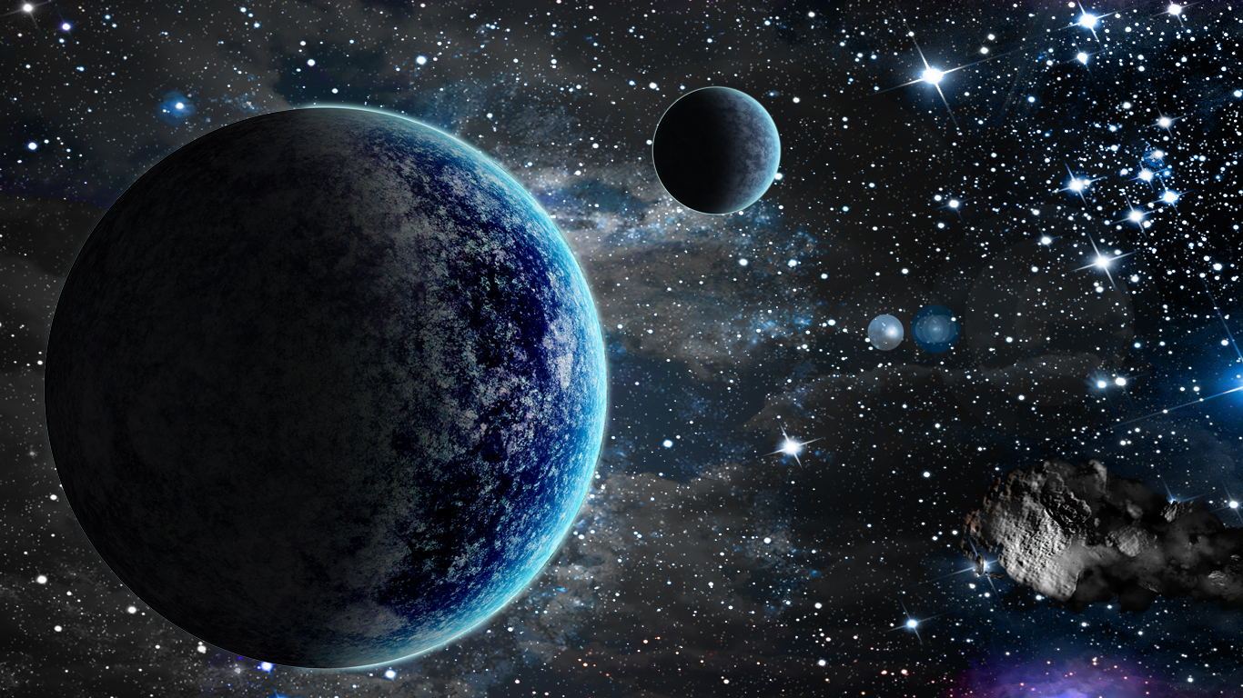
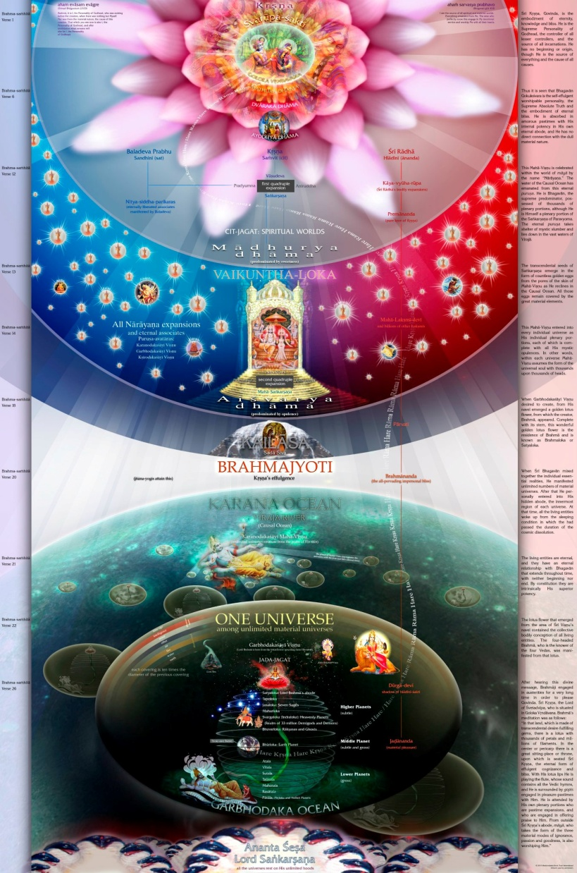
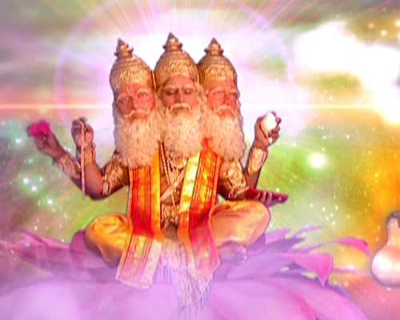
Sri Brahma Samhita: Verse-32

Slide 15
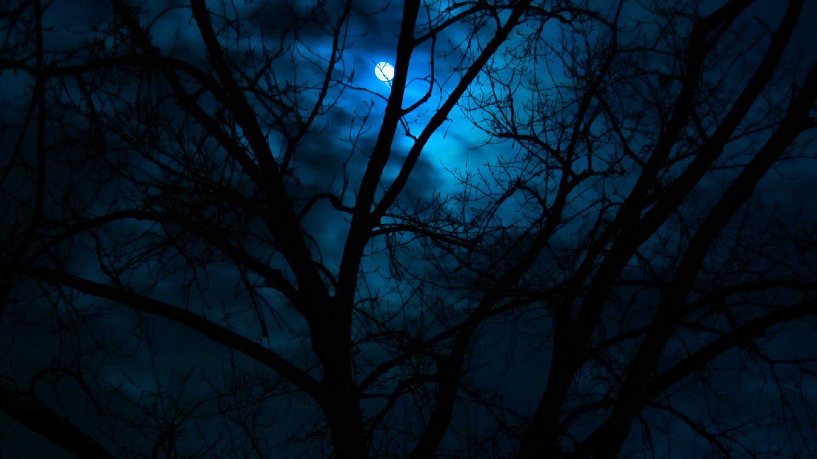
BS - 32
ańgāni yasya sakalendriya-vṛtti-manti
paśyanti pānti kalayanti ciraḿ jaganti
ānanda-cinmaya-sad-ujjvala-vigrahasya
govindam ādi-puruṣaḿ tam ahaḿ bhajāmi
I worship Govinda, the primeval Lord, whose transcendental form is full of bliss, truth, substantiality and is thus full of the most dazzling splendor. Each of the limbs of that transcendental figure possesses in Himself, the full-fledged functions of all the organs, and eternally sees, maintains and manifests the infinite universes, both spiritual and mundane...

Slide 16
ańgāni - the limbs
yasya - of whom
sakalendriya - of all the organs
vṛtti-manti – possesing functions
paśyanti - see
pānti - maintain
kalayanti - manifest
ciraḿ - eternally
jaganti – the universes
Notes:
Parama Isvara – Topmost controller
Anādi – No source of birth
Shiva – Maheshwara - mahāncha asa ishwara
Svetas
Katopanishad: Nityo Nityānām, Cetano Cetanām
Eko bahunām ved
Krishi Bhu

Slide 17
Ānanda - bliss
cit (n) – knowledge
maya - full of
sat - eternally
ujjvala - dazzling splendor
vigrahasya – whose form
govindam - Lord Krsna
ādi - original
puruṣaḿ - person
tam - Him
ahaḿ - I
bhajāmi - worship
Notes:
Parama Isvara – Topmost controller
Anādi – No source of birth
Shiva – Maheshwara - mahāncha asa ishwara
Svetas
Katopanishad: Nityo Nityānām, Cetano Cetanām
Eko bahunām ved
Krishi Bhu

Slide 18
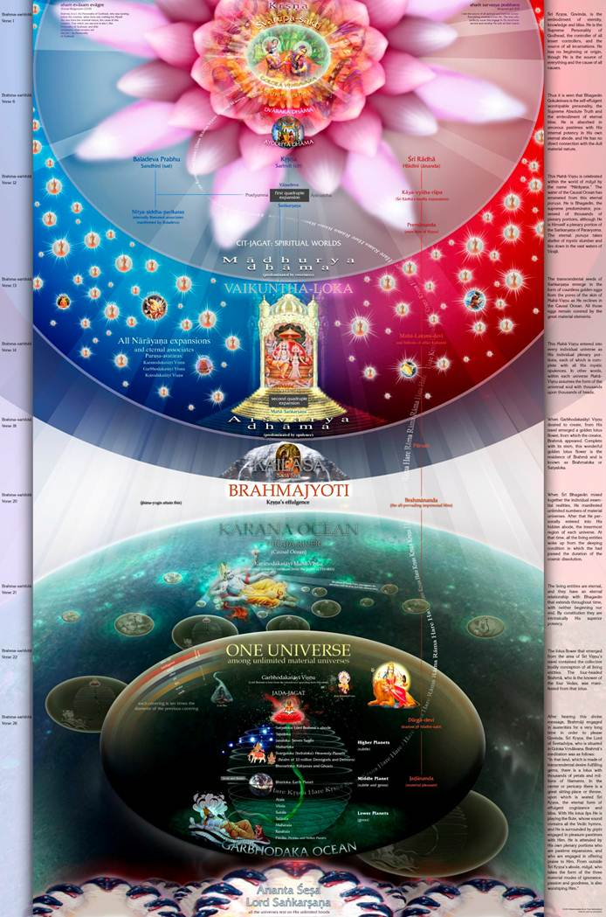
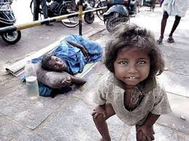
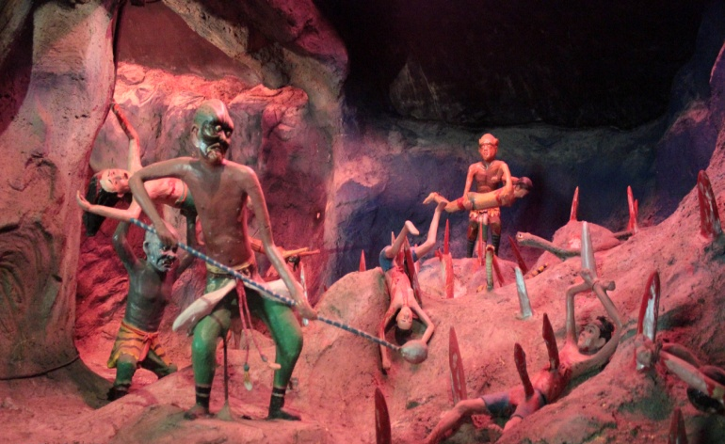
ańgāni ....
Siddha Deha
Nir Deha
Mayic Deha
Notes:
Material Body – Mayic Deha – Heaven (enjoy, decreasing), & Hell to suffer
NO Body (nobody!) – Brahman – No Deha – No sufferring no enjoyment
Spiritual Body – Siddha Deha – permanent bliss (ever increasing)

Slide 19
ańgāni yasya sakalendriya-vṛtti-manti
Notes:
ańgāni - the limbs
yasya - of whom
sakalendriya - of all the organs
vṛtti-manti – possesing functions

Slide 20
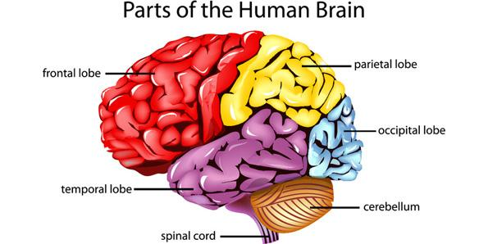
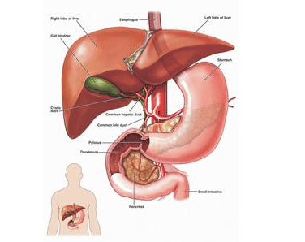
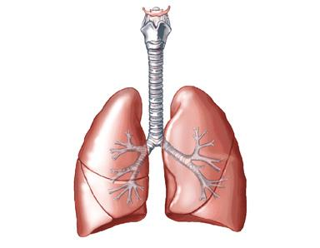
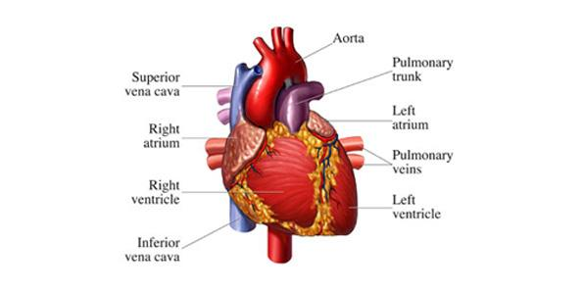
Notes:
Its functions are:
• Information processing
• Perception
• Movement control
• Arousal
• Homeostasis
• Motivation
• Learning and memory
Heart:
It acts like pump circulating blood in the body.
The function of Lungs is to exchange oxygen with the carbon dioxide present in blood.
Liver has many functions:
• Detoxification of food
• Protein synthesis
• Hormone production
• Decomposition of red blood cells
Liver entertains many bio-chemical reactions that are important for function of a body and that why it always better not to drink too much alcohol.

Slide 21
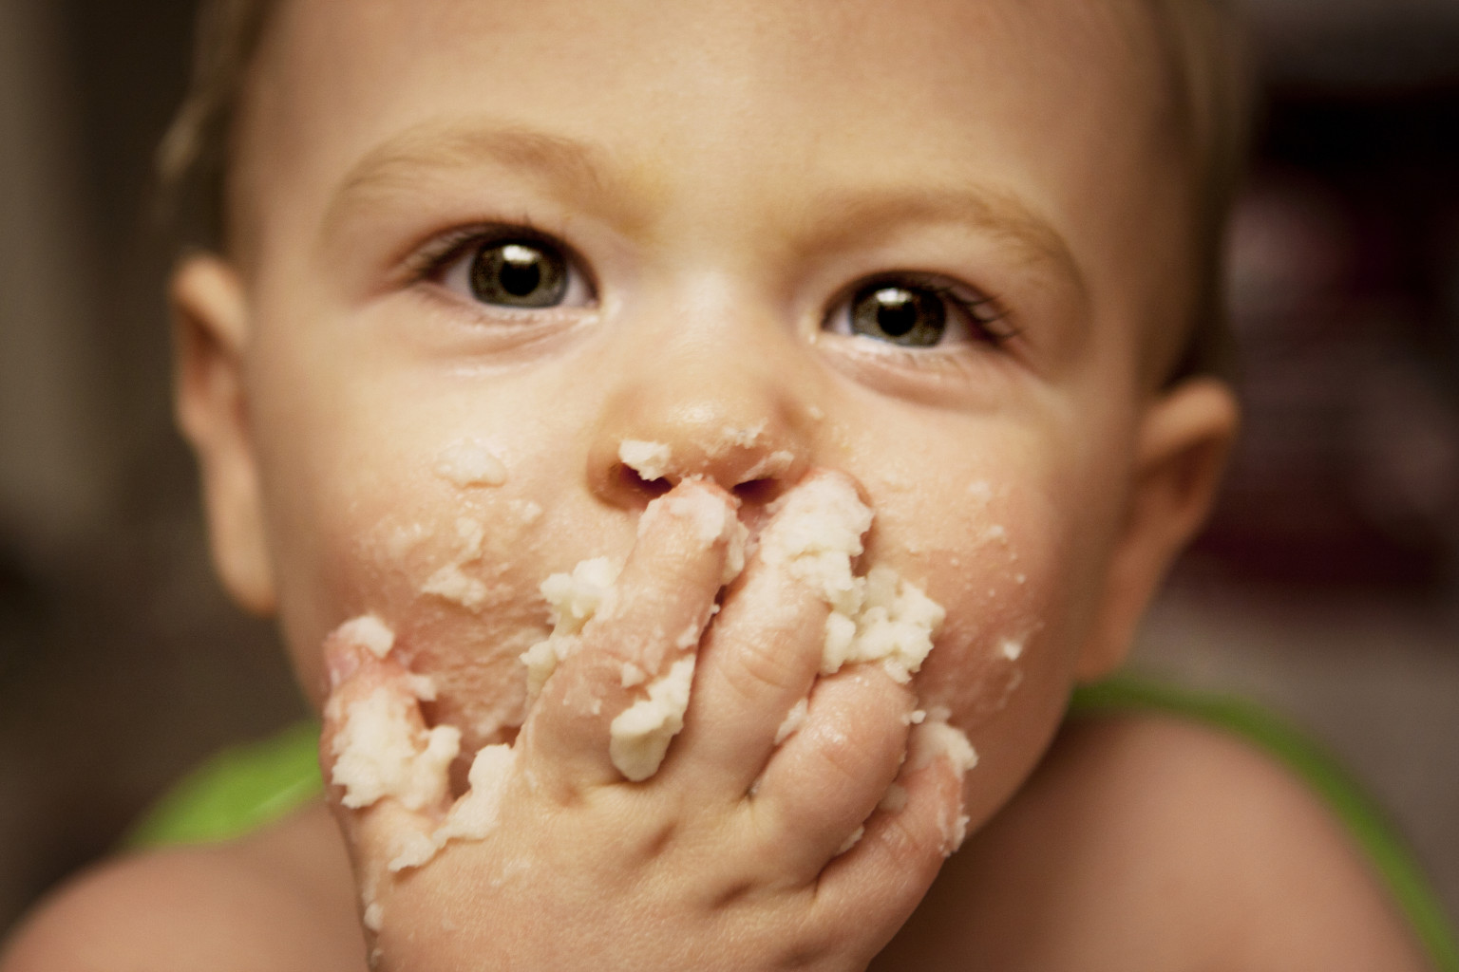
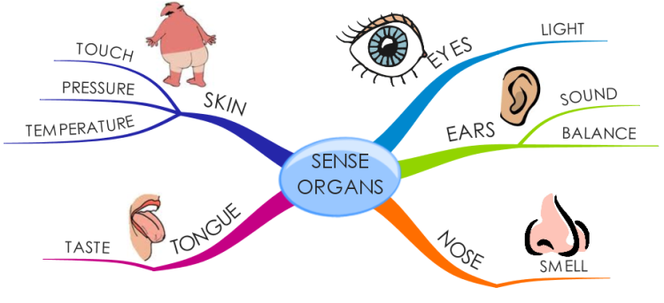
Notes:
Can we use one limb to work for another limb...?
Can we eat thru nose?, or thru ear?
Can you see thru your ears?
Can you hear thru your eyes?
Can you sing thru your eyes?
(You can sing thru your nose?)

Slide 22
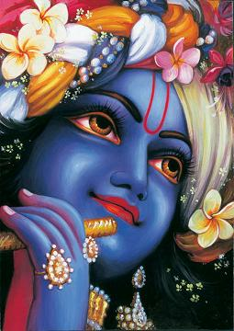
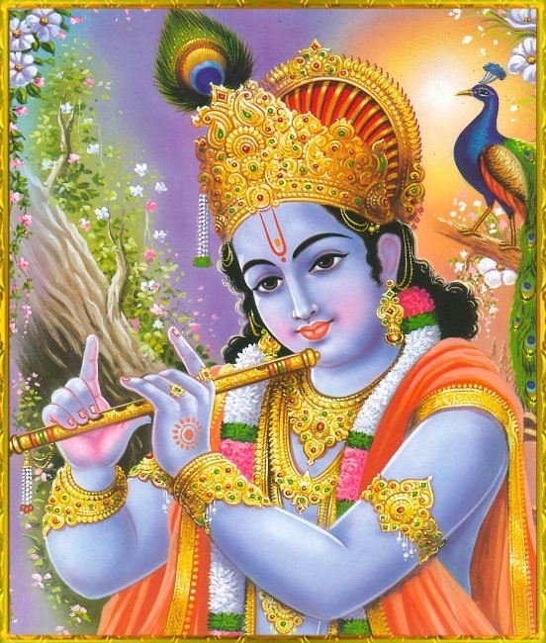
Notes:
But Krishna’s every limb can act as any other limb..
He can eat with His eyes..
He can hear with His finger, and so on.
...
Can we try any of those?

Slide 23
paśyanti pānti kalayanti ciraḿ jaganti
The Cosmic Beauty!
Notes:
paśyanti - see
pānti - maintain
kalayanti - manifest
ciraḿ - eternally
jaganti – the universes

Slide 24
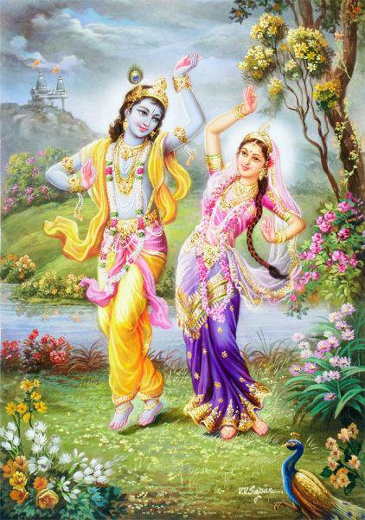
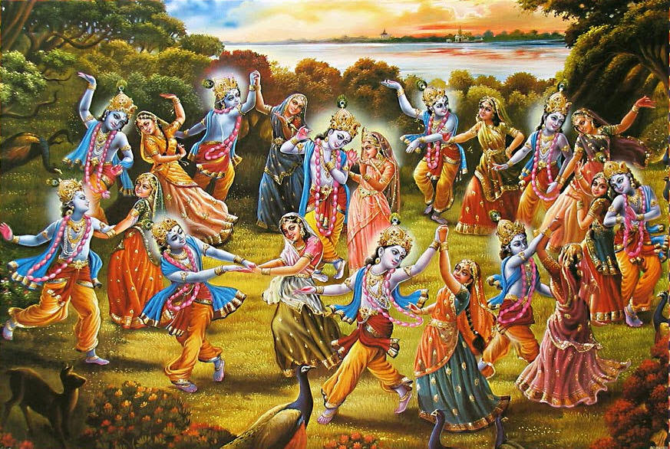
ānanda-cinmaya-sad..
Notes:
Sat-Cit-ānanda
Ānanda - bliss
cit (n) – knowledge
maya - full of
sat - eternally
ujjvala - dazzling splendor
vigrahasya – whose form

Slide 25
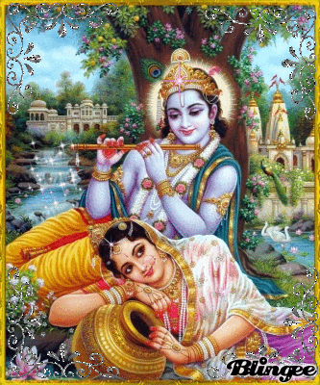
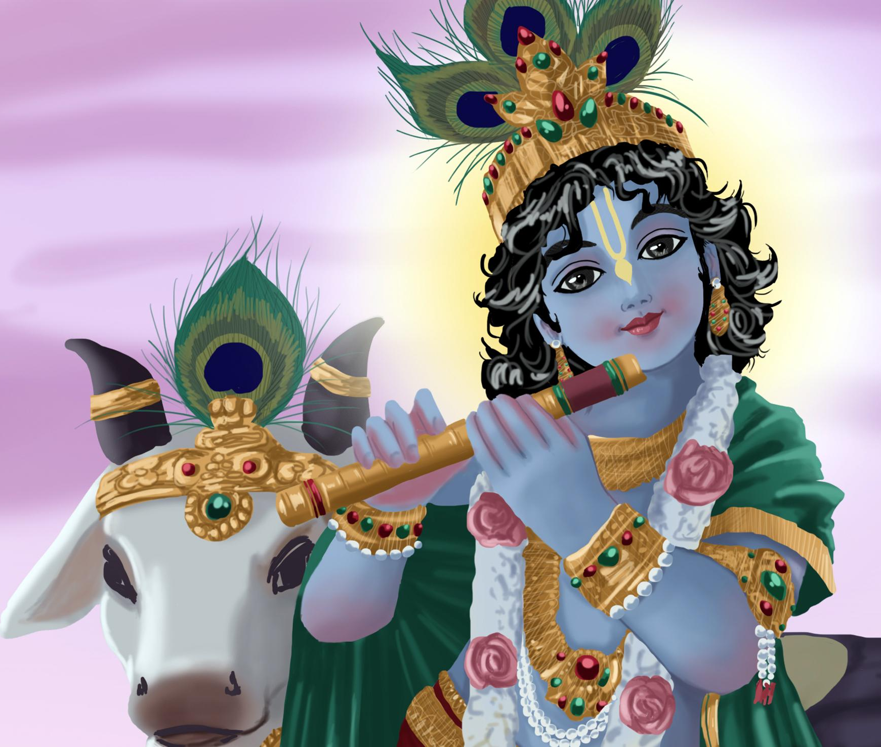
....ujjvala-vigrahasya
Notes:
Dazzling form...

Slide 26
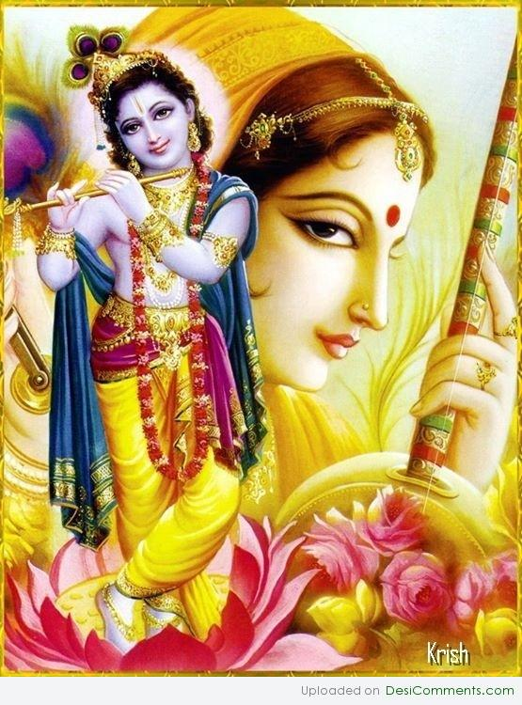
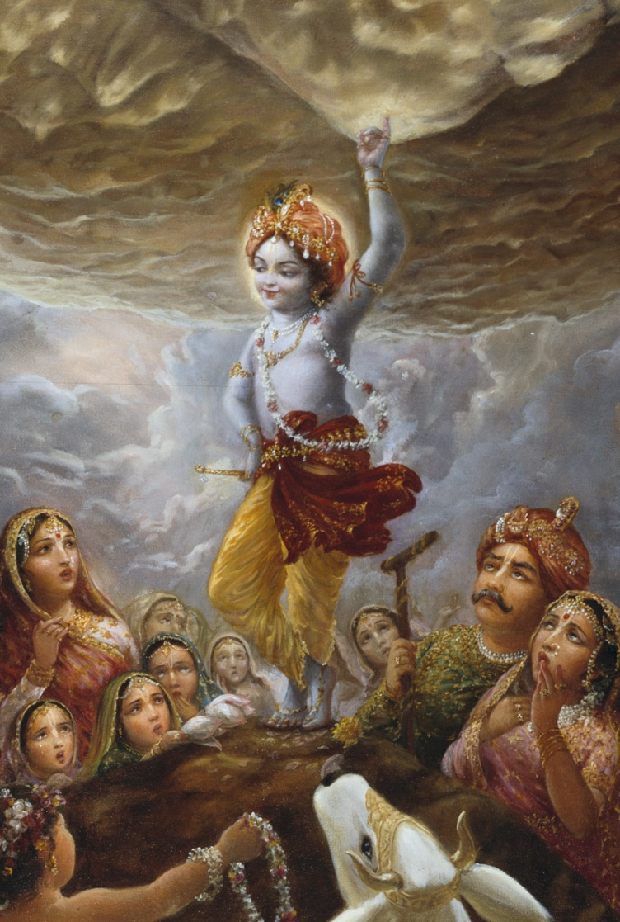

Slide 27
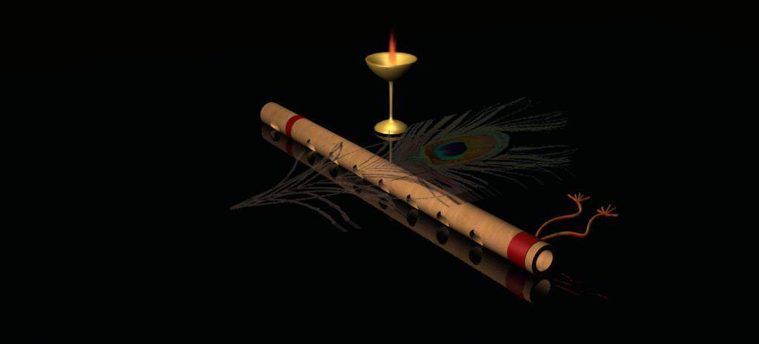
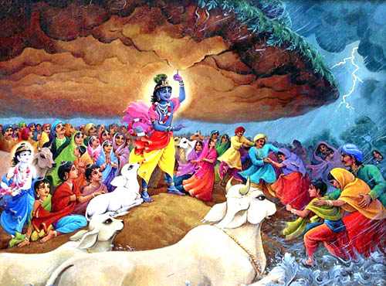
D-34
Giridhara gopālā
Bālā giridhara gopālā (2)
Shyāmala sharira kaustubha hāra (3)
Pitāmbara-dhara prabho murāre (2)
..... giridhara gopālā
Nanda sukumāra mana-mohanā-kāra (2)
Brindāvana-cara tulasi-hāra (2)
...... giridhara gopālā
Kamsa vidāra giridhara gopālā
kamsa vidara
mirā mānasa saro-vihāra (2)
....... giridhara gopālā

Slide 28
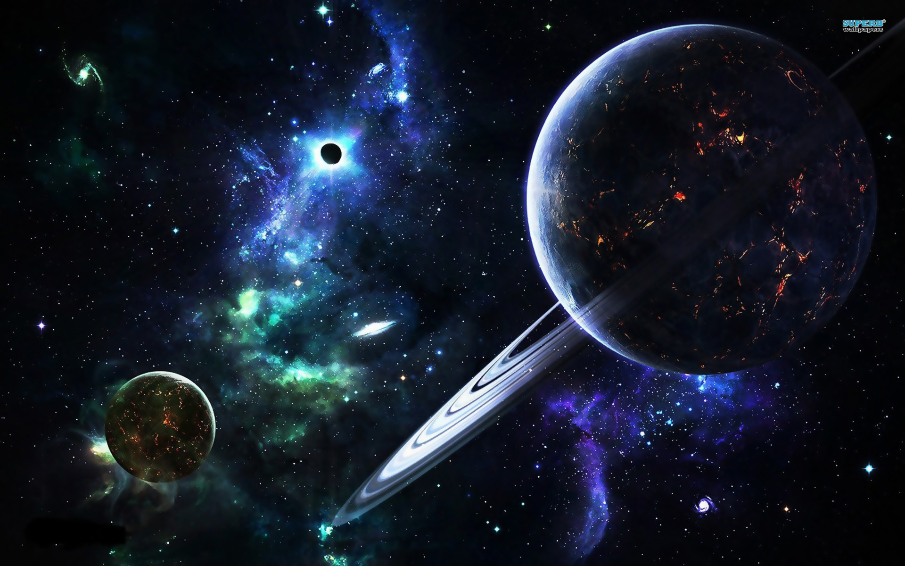
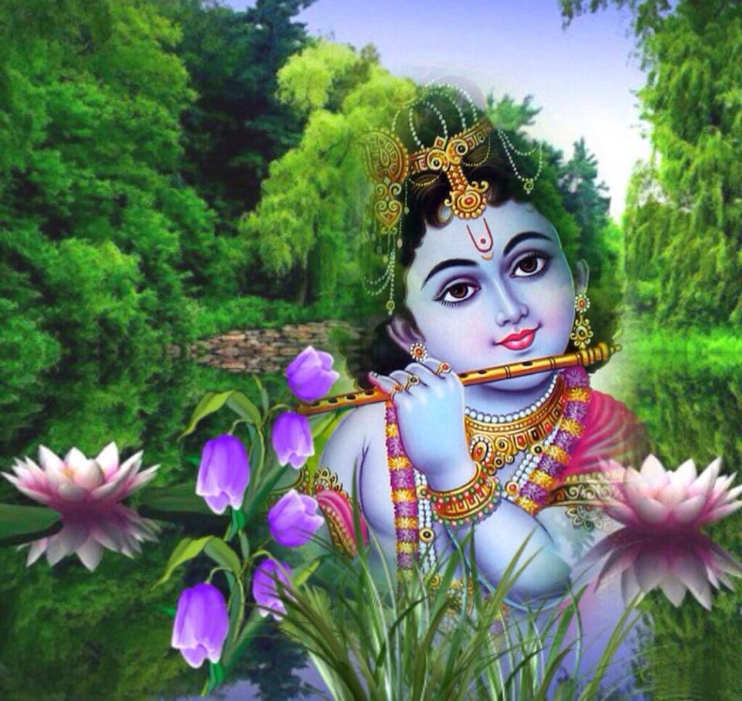
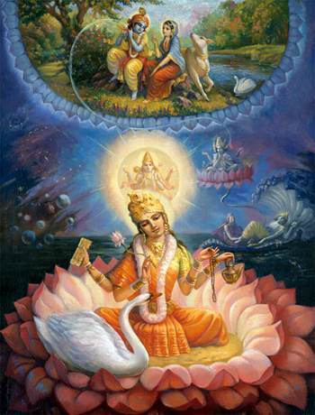
Thus ends...
Brahma Samhita – 04 (Verse 32)

